Slide 1
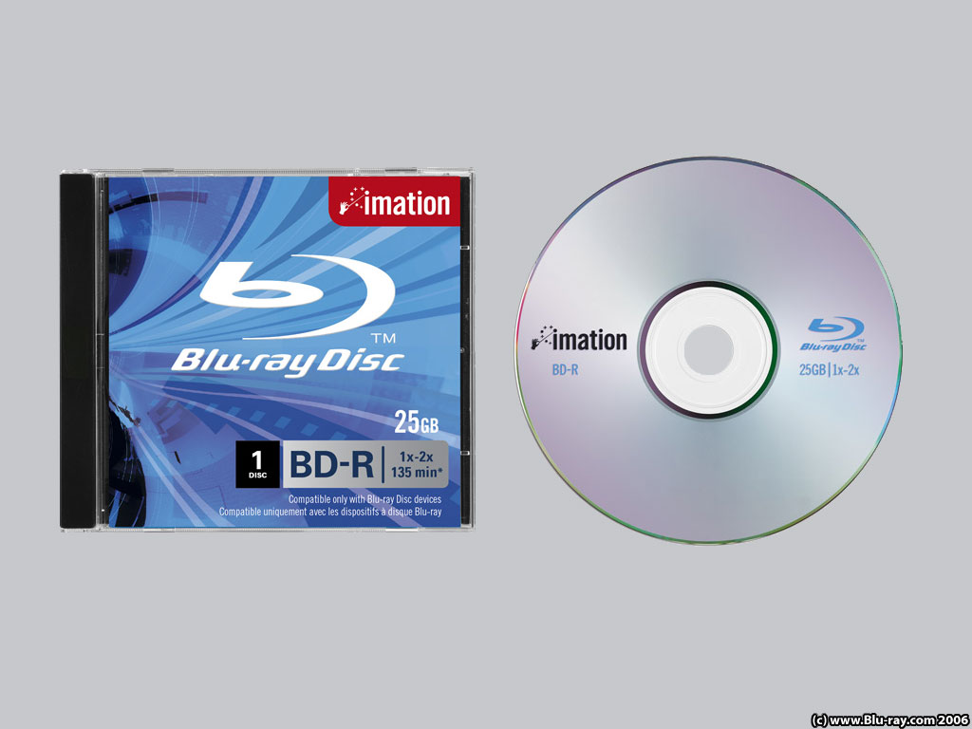
T h e B l u – r a y D i s c

Slide 2

Development
BD vs. DVD
Naming
BD vs. HD-DVD
Blu-ray Features
Applications
Video & Audio codecs
Released titles

Slide 3
The Blu-ray Disc
Media type : High –density Optical disc
Encoding : MPEG-2, MPEG-4 AVC (H.264), and VC-1
Capacity: 25 GB (single layer), 50 GB (dual layer)
Read mechanism: 1x@36 Mbit/s & 2x@72 Mbit/s
Developed by: Blu-ray Disc Association
Usage: Data storage, High-definition video and Play Station 3D Games

Slide 4
D e v e l o p m e n t
Developed by Blu-ray Association (BDA), a group of leading consumer electronics, personal computer and media manufacturers, with more than 180 member companies from all over the world. The Board of Directors currently consist of:
Apple Company, Inc. Dell Inc.
Hewlett Packard Company Hitachi Ltd.
Matsushita Electric Corporation LG Electronics Inc.
Samsung Electronics Co., Ltd. Pioneer Corporation
Electronics Sharp Corporation TDK Corporation
Royal Philips Sony Corporation Sun Microsystems, Inc.
Twentieth Century Fox Thomson Corporation
Warner Bros. Entertainment Walt Disney Pictures

Slide 5















Slide 6

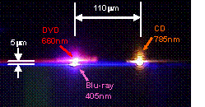
N a m i n g
The blu-ray disc uses blue violet laser with wave length of 405nm. So it is named as Blu-ray. Benefits of using blue violet laser(405nm)are :-
1- shorter wavelength than red laser (650nm), which makes it possible to focus the laser spot with even greater precision.
2-allows data to be packed more tightly and stored in less space
3-possible to fit more data on the disc even though it's the same size as CD/DVD.
4-with the change of numerical aperture to 0.85 is what enables Blu-ray Disc to hold 25GB/50GB.

Slide 7
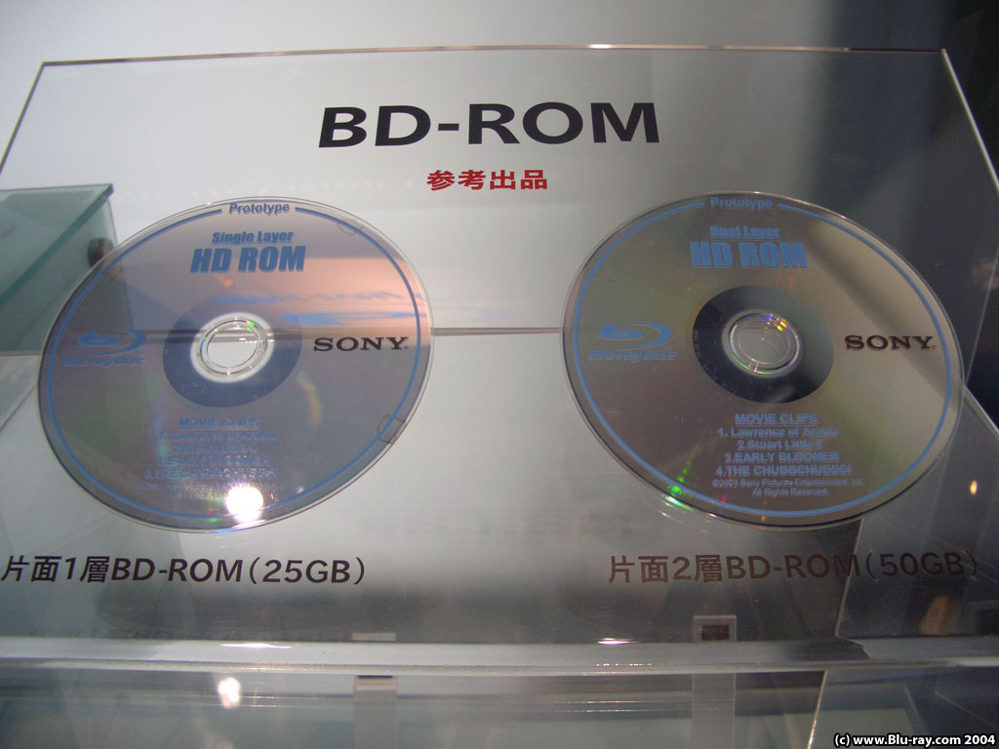
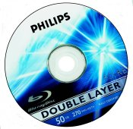
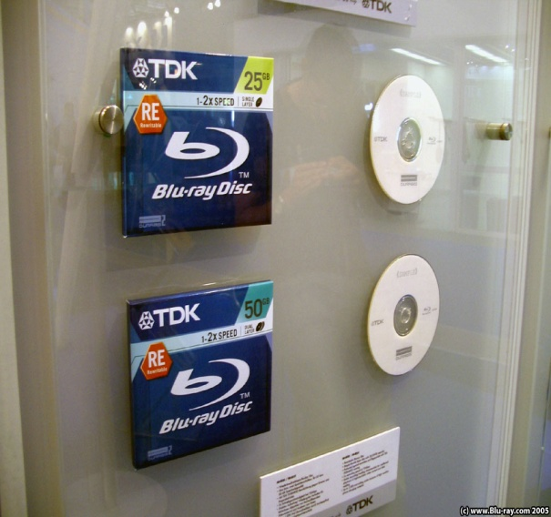
BD formats are available as
BD-ROM - read-only format for distribution of HD movies, games, software, etc.
BD-R - recordable format for HD video recording and PC data storage.
BD-RE- rewritable format for HD video recording and PC data storage.

Slide 8
B l u – r a y D i s c F e a t u r e s
1:Massive storage capacity: 25 GB (single layer) or 50 GB (dual layer) on a single-sided disc, compared to 4.7 (single layer) and 8.5 GB (dual layer) on a single-sided DVD disc
Physical size
Single layer capacity
Double layer capacity
12cm, single sided
25GB
50GB
12 cm, double sided
50GB
100GB
8 cm, single sided
7.8GB
15.6GB
8 cm, double sided
15.6GB
31.2GB

Slide 9
2:High-definition content: Supports high bit rate, high-definition video at resolutions of up to 1920 x 1080, compared to DVD's 640 x 480, in progressive and interlaced formats
About 9hrs of high-definition (HD) video can be stored on a 50GB disc. About 23hrs of standard-definition (SD) video can be stored on a 50GB disc. On average, a single-layer disc can hold High Definition features of 135 minutes using MPEG-2, with additional room for 2 hrs of bonus material in standard definition quality. A dual layer disc will extend this number up to 3hrs in HD quality and 9hrs of SD bonus materials.
3.Compatible with CDs and DVDs: Same size and look as CD and DVD, enabling Blu-ray Disc drives that can read and write CDs and DVDs.
4.Robust content protection: Strong protection that is transparent to end users.

Slide 10
R e a d w r i t e s p e e d
According to the Blu-ray Disc specification, 1x speed is defined as 36Mbps. However, as BD-ROM movies will require a 54Mbps data transfer rate the minimum speed we're expecting to see is 2x (72Mbps).
Blu-ray also has the potential for much higher speeds, as a result of the larger numerical aperture (NA) adopted by Blu-ray Disc. The large NA value effectively means that Blu-ray will require less recording power and lower disc rotation speed than DVD and HD-DVD to achieve the same data transfer rate.

Slide 11
A u d i o a n d v i d e o c o d e c s u s e d i n B D
Video codecs
MPEG-2
MPEG-4 AVC
SMPTE VC-1

Slide 12
Audio Codecs
Linear PCM (LPCM):
up to 8 channels of uncompressed audio. (mandatory)
Dolby Digital (DD):
format used for DVDs, 5.1-channel surround sound. (mandatory)
Dolby Digital Plus (DD+):
extension of Dolby Digital, 7.1-channel surround sound. (optional)
Dolby TrueHD:
lossless encoding of up to 8 channels of audio. (optional)
DTS Digital Surround:
format used for DVDs, 5.1-channel surround sound. (mandatory)
DTS-HD High Resolution Audio:
extension of DTS, 7.1-channel surround sound. (optional)
DTS-HD Master Audio:
lossless encoding of up to 8 channels of audio. (optional)

Slide 13
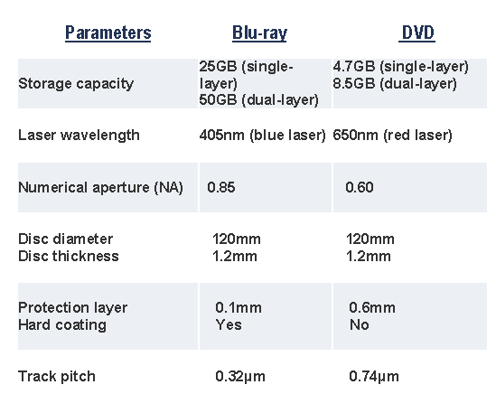
B D vs. D V D

Slide 14
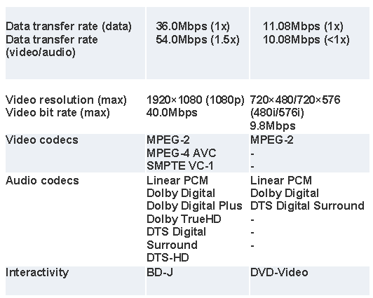
Cont’d

Slide 15
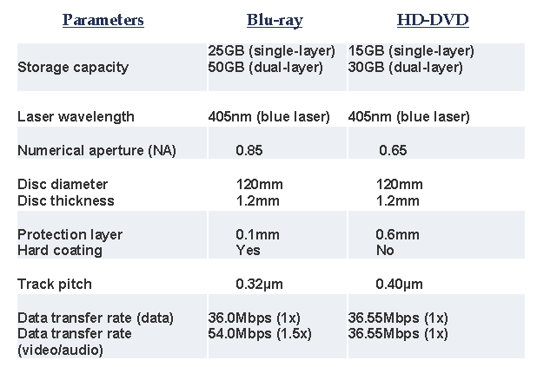
B D vs. H D – D V D

Slide 16
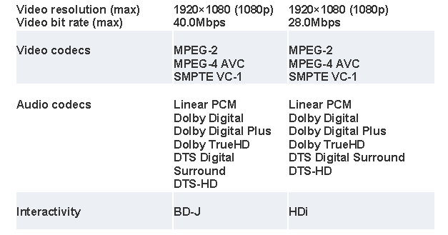
Cont’d

Slide 17

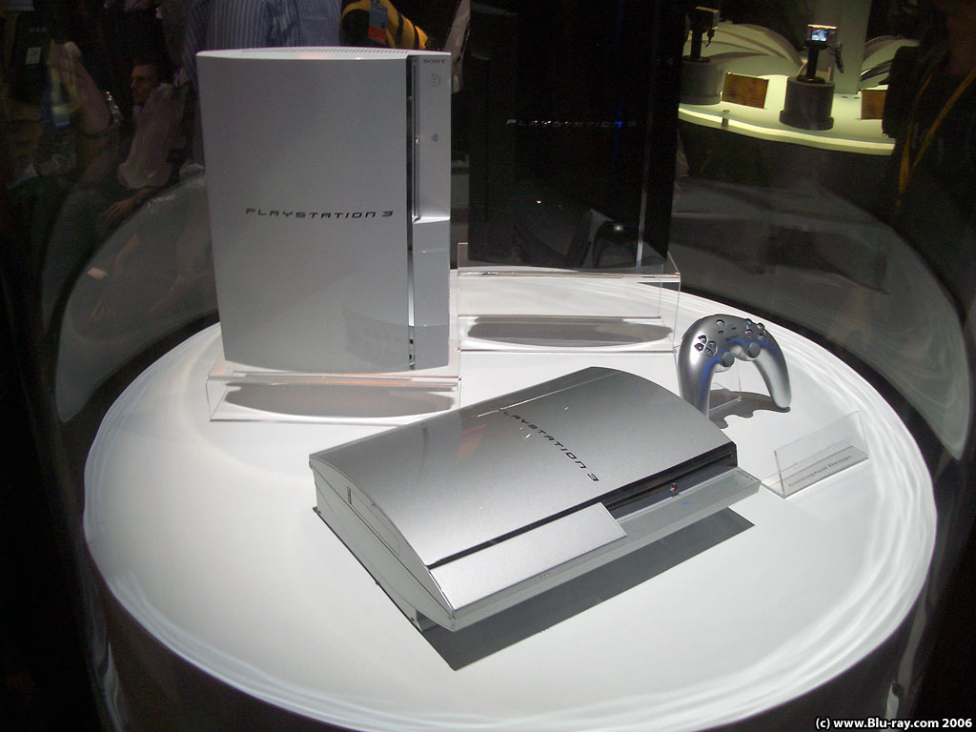
A p p l i c a t i o n s o f B D
1-Stand alone players

Slide 18
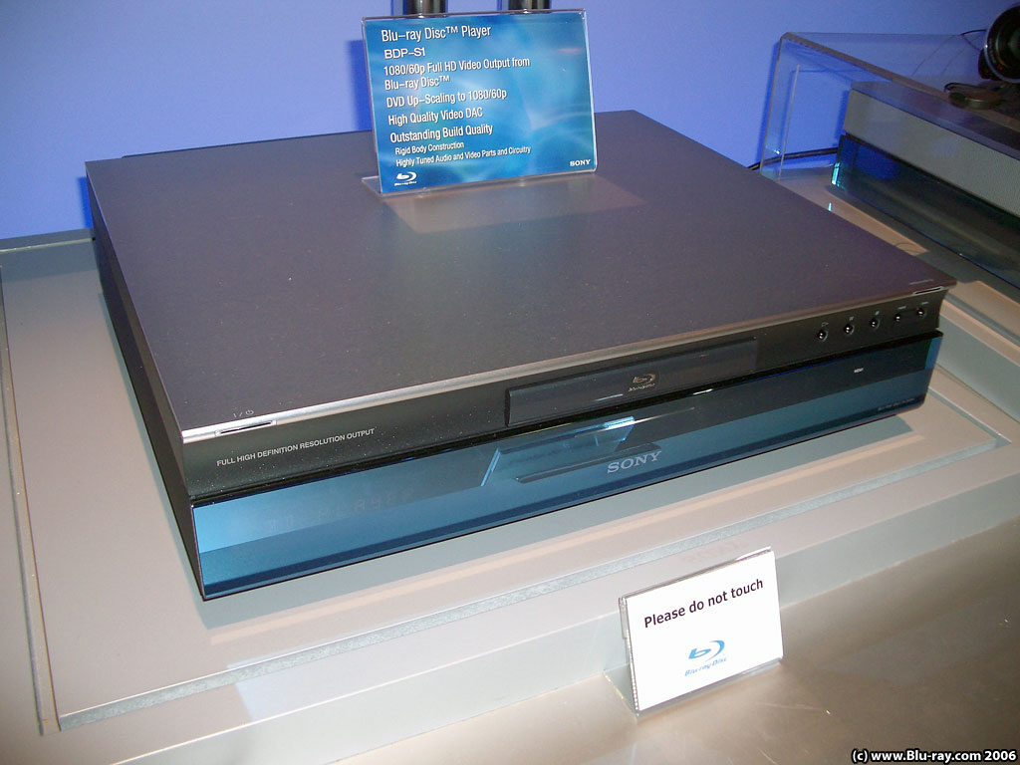
Cont’d
2-Recordable stand alone players

Slide 19
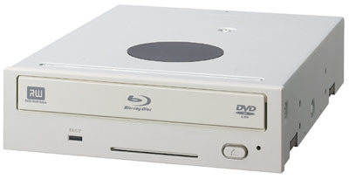
Cont’d
3 -Portable stand alone players
4-Universal player (Blu-ray and HD-DVD)
5-PC drives
6-Recordable PC drives

Slide 20
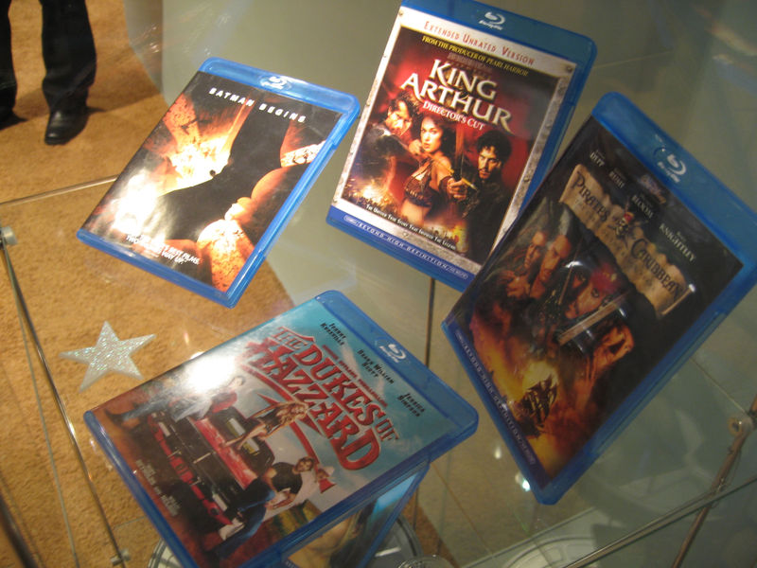
Released titles

Slide 21
Sony titles
o Hitch
o The Fifth Element
o House of Flying Daggers
o Underworld: Evolution
o 50 First Dates
·
MGM titles
o The Terminator
· Disney titles
o King Arthur
o Pirates of the Carribean: The Curse of the Black Pearl
· Warner Bros. titles
o Batman Begins
o The Dukes of Hazzard

Slide 22
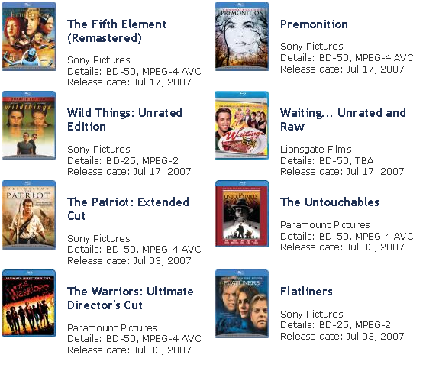
New Releases

Slide 23
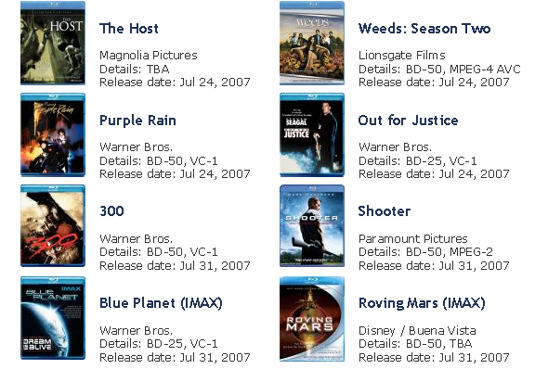
Upcoming movies

Slide 24
Ongoing Development
Engineers are working in order to advance the Technology
Quad-Layer(100GB) BD
BD (200GB) ,single sided using
6(33GB) data layer

Slide 25

The Blue-ray Technology
Is going to dominate the next decade

Slide 26

Thank You
all
for giving me
your
valuable time

